Slide 1
Pathogenic bacteria.
Dr.Munira Ch. Ismail Lec.8,9

Slide 2
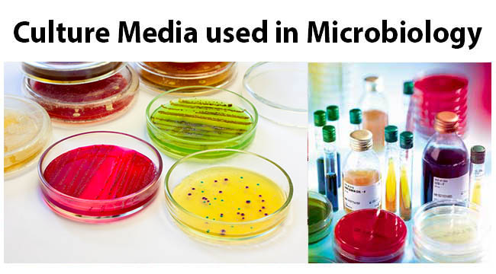
.
GRAM NEGATIVE RODS.
It comprises the following bacterial groups:
1. Oxidase negative.
. Enterobacteriaceae.
a. Lactose-fermenters
. Escherichia spp.
. Klebsiella spp.
. Enterobacter spp.
. Citrobacter spp.
b. Non-lactose fermenters
. Salmonella spp.
. Shigella spp.
. Proteus spp.
2. Oxidase Positive
. Pseudomoas.
. Vibrio.
.Campylobacter
. Helicobacter.

Slide 3
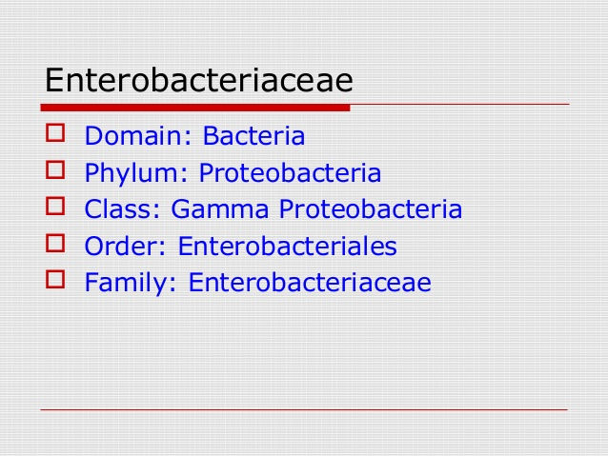
Characteristics:
Named, as well coliforms or enterobacilli:
. Found as normal flora in intestinal tract of humans and animals.
. Gram-negative, non-spore forming, aerobic and facultativeanaerobic
bacteria.
. Most are motile.
. Grow over a wide range of temperature in ordinary media.
. All ferment glucose with acid production.
. Oxidase negative.
. Release endotoxin from their cell wall.
. Some release exotoxin.

Slide 4
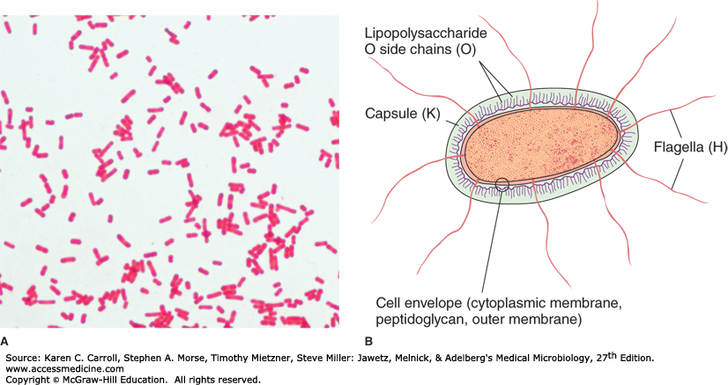
Antigenic structures

Slide 5
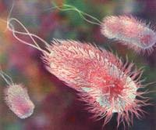
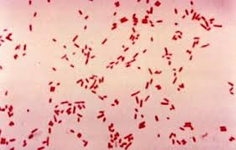
GENUS:ESCHERICHIA.
. Main species of medical importance is Escherichia coli.
Escherichia coli.
Characteristics:
. Normal flora in human and animal gastrointestinal tract.
. Found in soil, water and vegetation.
. Most are motile; some are capsulated.
Escherichia coli.

Slide 6
Clinical features:
. Urinary tract infection- cystitis, pyelonephritis
. Wound infection- appendicitis, peritonitis
. Neonatal septicemia and meningitis
. E.coli-associated diarrheal disease:
1. Enteropathogenic E.coli(EPEC).
. causes outbreaks ofself-limiting infantile diarrhea.
. they also cause severe diarrhea in adults.
. antibiotic tretment shorten the duratin of illness and cure diarrhea.
2. Enteroinvasive E.coli(EIEC).
. Non-motile, non-lactose fermenting E.coli invade the mucosa of the ileum and colon, and causes shigellosis-like dysentery in children in developing countries and travellers to these countries.

Slide 7
3. Enterotoxigenic E.coli(ETEC).
. Colonization factor of the organism promote adherence to epithelial cells of small intestine,followed by release of enterotoxin which causes
toxin-mediated watery diarrhea in infants and young adults.
. It is an important cause of traveller’s diarrhea.
. Antibiotic prophylaxis can be effective but may increase drug resistance (Should not be uniformly recommended).
4. Entero haemorrhagic E.coli( EHEC).
Cytotoxic verotoxin producing E.coli serotype
O157:H7 causes haemorrhagic colitis (severe
form of diarrhea), and hemolytic uremic
syndrome characterized by acute renal failure,
hemolytic anemia and low platelet count
5. Enteroaggressive E.coli( EAEC).
.Adhere to human intestinal mucosal cells and produce ST-like toxin and hemolysin, and causes acute and chronic diarrhea in persons in
developing countries.
. Produce food-borne illness
in developed countries.
6.Diffusely-adherent E. coli (DAEC).
.Recently, diffusely adherent E. coli (DAEC) strains have been recognized as the sixth class of diarrheagenic E. coli and appear as a heterogeneous group.

Slide 8
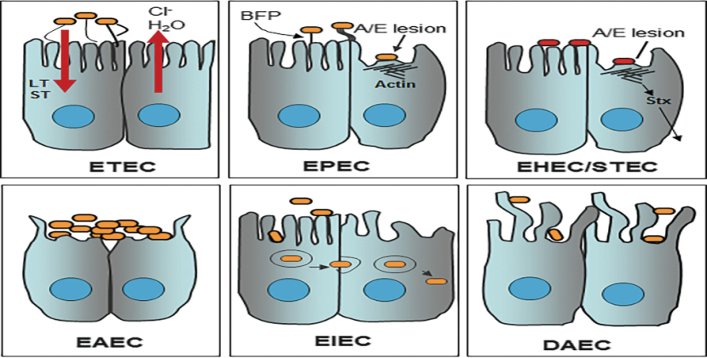
E.coli-associated diarrheal disease

Slide 9
Lab.diagnosis:
Specimen: Urine, pus, blood, stool, body fluid.
Smear: Gram-negative rods.
Culture: Lactose-fermenting mucoid colonies on mac conkey agar and some strains are hemolytic on blood agar .
Biochemical reaction: Produce indole from tryptophancontaining
peptone water.
Reduce nitrate to nitrite.
Serology: For serotyping (Epidemiologic information).

Slide 10
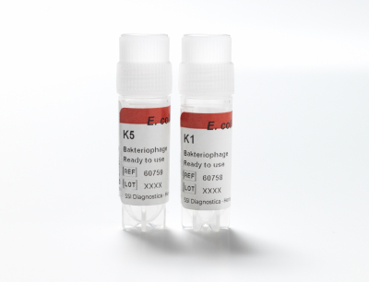
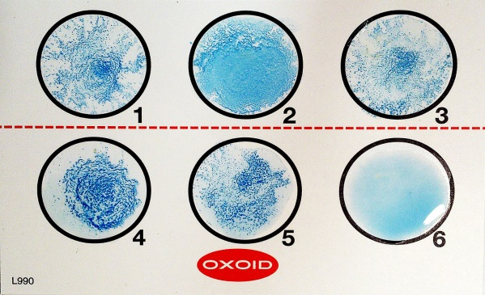
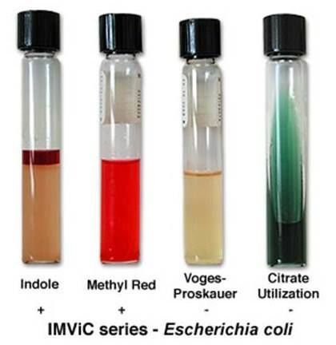
E. coli antiSERA

Slide 11
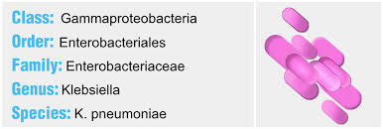
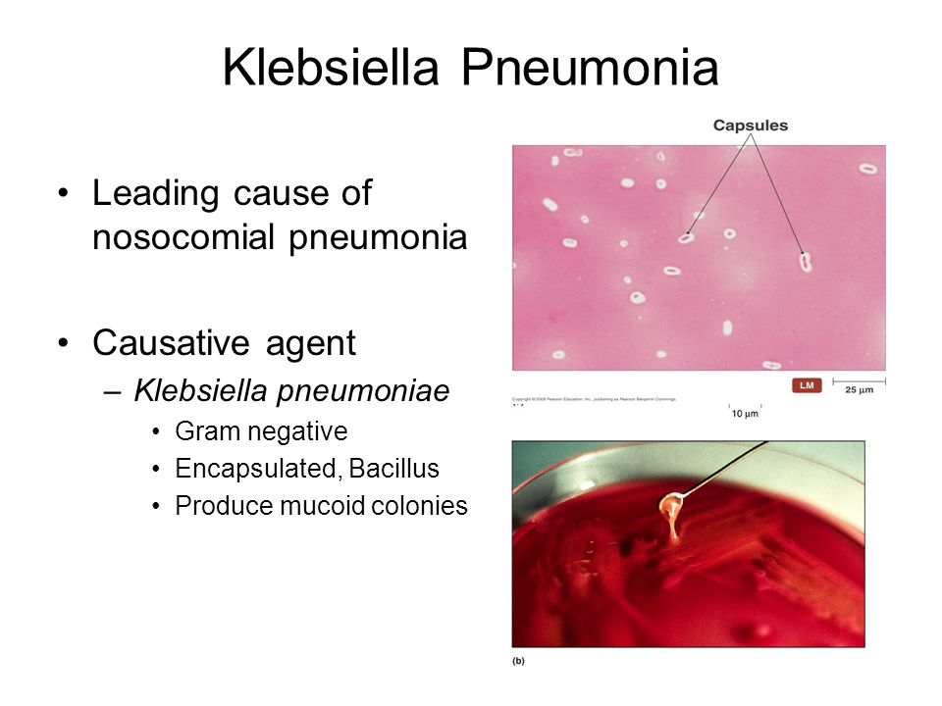
Genus: Klebsiella.

Slide 12
Characteristics:
Non-motile, lactose-fermenting, capsulated, gram-negative rods.
Main species of medical importancce:
K. pneumonia.
K. rhinoscleromatis.
K. ozenae.
K.pneumoniae.
It is found as a commensal in the intestinal tract, and also found in moist environment in hospitals.
It is an important nosocomial pathogen.
It causes:
. Pneumonia.
. Urinary tract infection.
. Septicaemia and meningitis (especially in neonates).
. Wound infection and peritonitis.
K. rhinoscleromatis.
It causes rhinoscleroma of nose and pharynx to extensive destruction of nasopharynx (hebra nose).
K.ozaenae.
It causes ozena manifesting with foul smelling nasal discharge leading to chronic atrophic rhinitis.

Slide 13
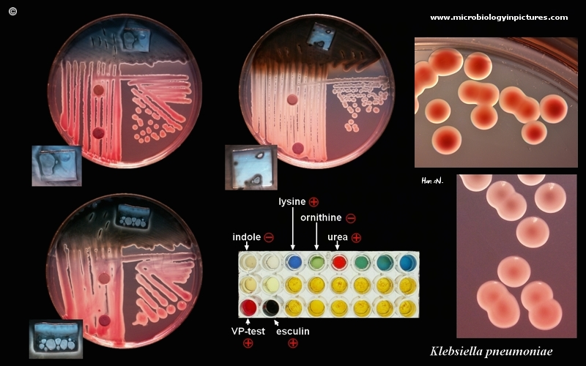
Laboratory diagnosis of klebsiella species:
Specimen: Sputum, urine, pus, CSF, body fluid.
Smear: Gram-negative rods.
Culture: Large, mucoid, lactose-fermenting colonies on mac conkey agar, and shows stringy type growth when cultured in broth medium.

Slide 14

GENUS: ENTEROBACTER.
It is gram-negative lactose fermenting motile rods, and found as a commensal in the intestinal tract of humans and animals and moist
environments.
Medical important species is Enterobacter aerogens.It produces mucoid colony resembling klebsiella on Mac Conkey agar.
Enterobacter aerogens is associated with urinary tract infection,wound infection and septicaemia in immunocompromised and chronically deblitated patients.

Slide 15
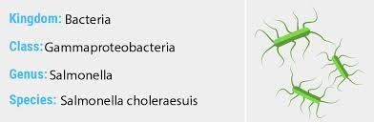
GENUS: CITROBACTER.
It is gram-negative lactose fermenting motile rods, and opprtunistic
pathogen.
Medical important species is Citrobacter freundii.
Citrobacter freundii is associated with urinary tract infection, wound
infection and septicaemia in immunocompromised and chronically
deblitated patients.
GENUS: SALMONELLA.

Slide 16
Most isolates of salmonellae are motile.
It grows readily on simple media.
It never ferment sucrose or sucrose.
Form acid +/- acid from glucose or mannose.
Species of medical importance are:
S. typhi.
S. paratyphi.
S. enteritidis.
Clinical features:
1. Enteric fever.
It is caused by S.typhi and S.paratyphi, and transmitted by fecal-oral route via contaminated food and drinks.
Incubation period: 10-14 days.
Predisposing factors:
.Reduced gastric acidity.
.Disrupted intestinal microbial flora.
.Compromised local intestinal immunity.

Slide 17
2. Bacteremia with focal lesions.
Causative agent: S. choleraesuis.
Manifests with blood stream invasion with focal lesions in lungs, bones and meninges Intestinal manifestation are often absent.
3. Gastroenteritis.
It is caused by S. enteritidis,S. typhimurium.
IP= 8-48 hrs.
It manifests with initial watery diarrhea, and later bloody mucoid diarrhea associated with crampy abdominal pain and tenesmus.
Bacteremia is rare (2-3 % of cases).
It usually resolves in 2-3 days.

Slide 18
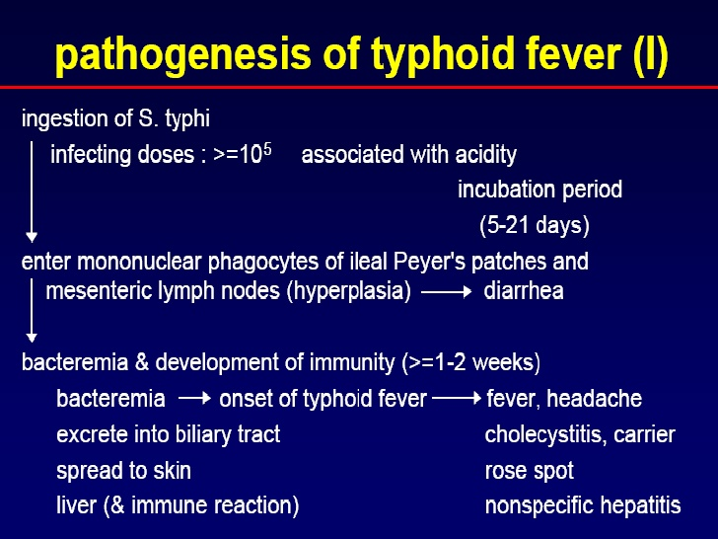

Slide 19
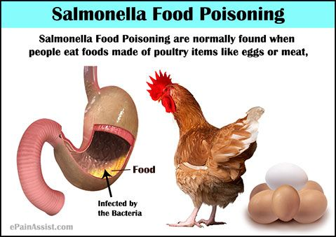
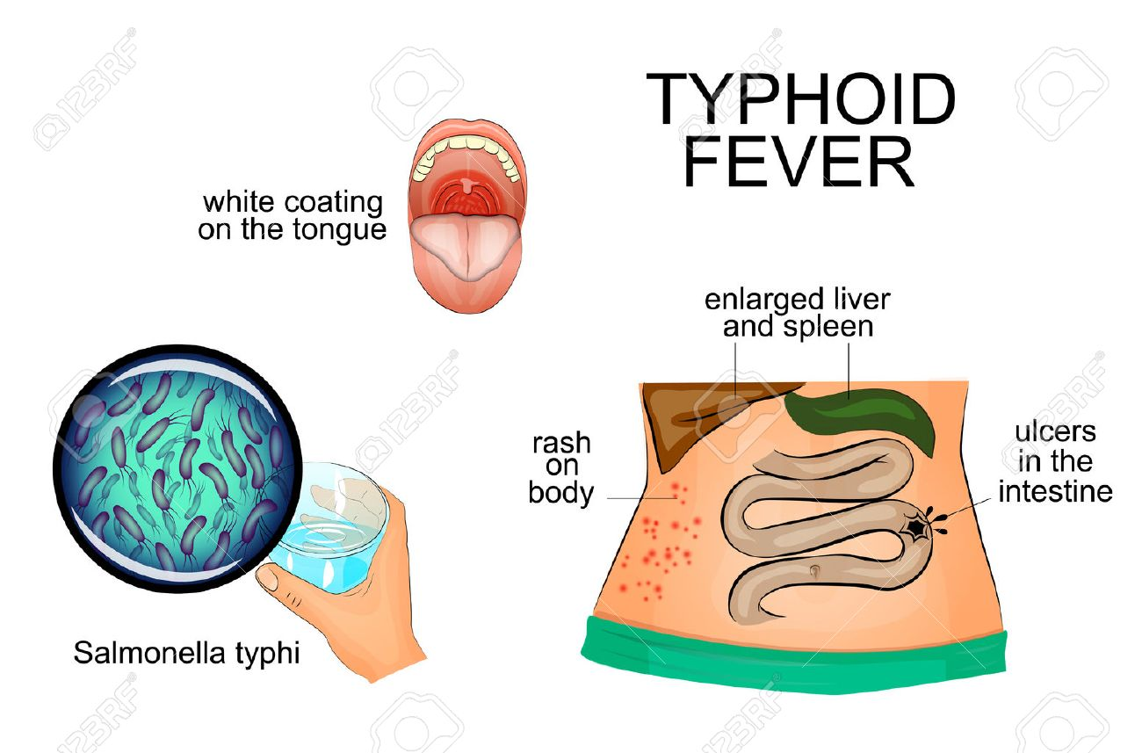

Slide 20
Laboratory diagnosis:
Specimen:
1. Blood, Bone marrow, stool, urine and serum for enteric fever.
. Blood – 80% positive in the first week.
. Stool- 70-80% positive in the second and third week.
. Urine- 20% positive in the third and fourth week.
. Serum for widal test- positive after the second week of illness.
2. Stool for gastroenteritis.
Gram reaction: Gram-negative rods.
Culture: Bacteriologic methods for salmonella isolation.
1. Differential medium.
. For rapid isolation of lactose non-fermenters
Egs. EMB agar.
Mac Conkey agar.
Deoxycholate agar.
2. Selective medium
. favor growth of salmonella and shigella over other enterobacteriaceae.
Egs. SS agar.Hekton Enteric agar.XLD agar.Deoxycholate-Citrate agar.

Slide 21
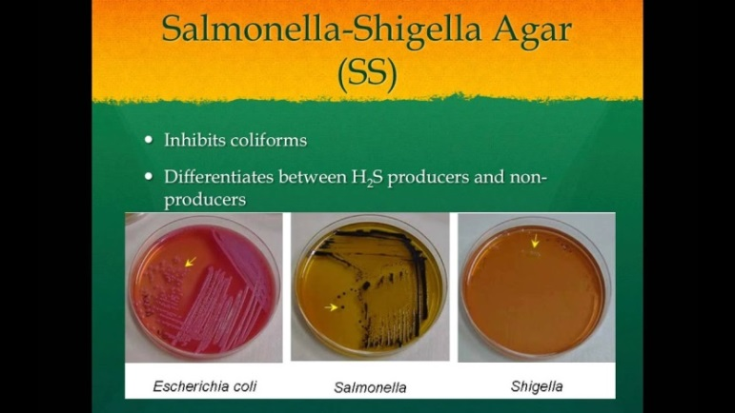
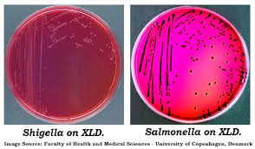
Xylose Lysine Deoxycholate(XLD) agar.

Slide 22
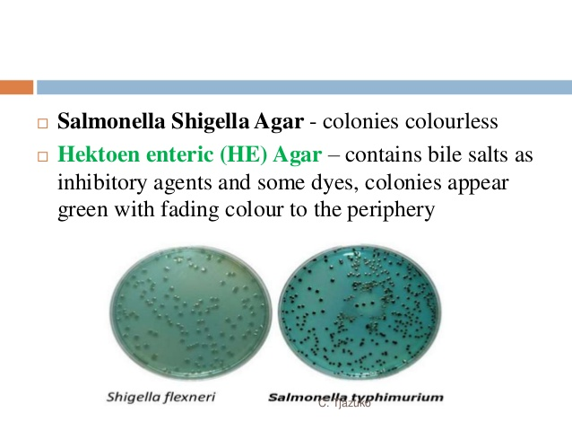
Hekton Enteric agar
3. Enrichment cultures
. Inhibit replication of normal intestinsl flora and permit replication of salmonella.
Egs. Selenite F broth.
Tetrathionate broth.
Non-lactose fermenting , H2S producing colonies in Mac conkey agar.
Biochemical reaction: Generally produce gas and acid from carbohydrate; except S.typhi which does not produce gas.

Slide 23
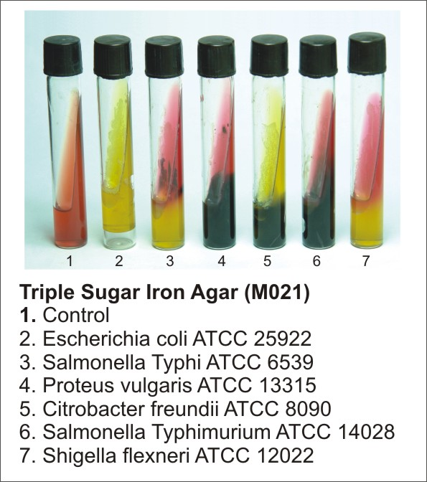
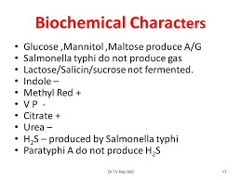

Slide 24
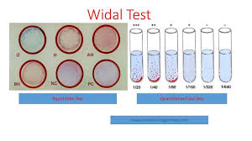
Serology: (wiedal test).
a. Tube dilution agglutination test.
Used to determine antibody titers in patients with unknown illness.
Method:
• Serial dilutions of unknown serum are tested against antigens from
representative salmonella species.
• The highest diluted serum with positive result is taken as a tite.

Slide 25


